Slide 1
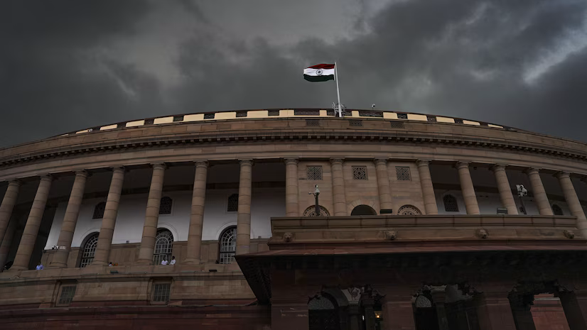
Factors Behind The Failure Of Indian Education System
Presented by
K. Ashok
24 Apr 2025

Slide 2
Table of contents
Back Story
Business Objective
Approach
Suicides in Indian Education System
Indian Education System Faults
Operational Failures in Education
Corruption and Scams in the Education system
International Comparison – PISA Scores
Global Best Practices in Education
Policy Interventions and Impact on Student Suicides
Key Pillars for Strengthening India's Education System
Conclusion

Slide 3
Color Palette
Color Name | Hex code | Usage
Straw | #E5D097 | Heading
Mustard Gold | #E1B75E | Sub Heading
Dandelion | #EAEA54 | Tertiary Heading
Cornflower blue Light Red Light Coral Light Green Sky Blue Amethyst | #6B8DE3 #F28D8D #F2B591 #C2E19A #ACE2F2 #C28DDA | Visualization

Slide 4
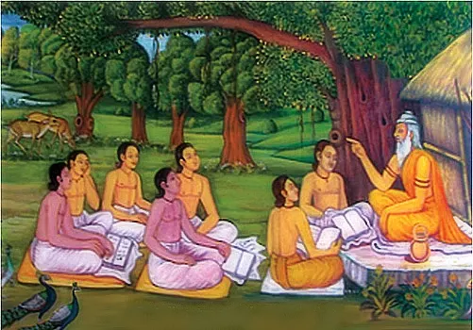
Gurukul’s Pathshala’s Nalanda Takshashila vikramashila
Back Story
Ancient Schools & Universities:

Slide 5
Bussiness Objective
Understand education-related suicide trends in India
Analyze systemic issues: exam pressure, scams, failure of reforms
Learn from global education models (PISA, policy benchmarks)
Recommend reforms to create a supportive academic environment

Slide 6
Approach
1. Problem Identification
Analyzed trends in student suicides in India from NCRB data
Identified key issue: high suicide rates linked to academic pressure, especially around exam failure
2. Data Collection
Collected suicide data from NCRB reports (2013–2021)
Focused on state-wise suicide statistics
Included policy implementation years from government sources
3. Data Cleaning & Preparation
Removed irrelevant categories like ‘No Education’ or ‘Status Unknown’
4. Exploratory Data Analysis (EDA)
Visualized suicide trends across years, states
Highlighted before vs. after trends for states like Kerala and Tamil Nadu
Compared Indian education system with top 10 global education models
5. Policy Mapping
Mapped education reforms (e.g., NEP 2020, state-level strategies) against suicide trends
Created visual storytelling using radial charts for reform impact and global comparison

Slide 7
Suicides in Indian Education System
Key Facts:
Total student suicides (1,05,896+ in 2022 – NCRB)
High suicide rates in 15–29 age group
Common reasons:
Securing Pass Mark
Over-Ambitious Parents

Slide 8
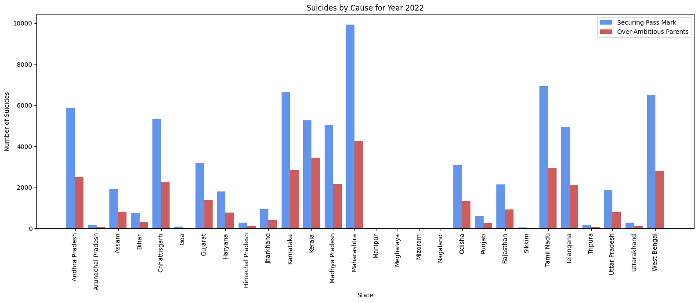

Slide 9
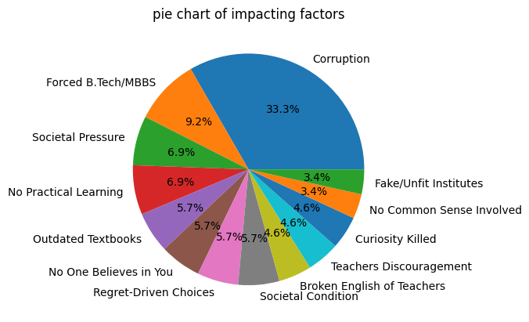
Indian Education System Faults
Academic Pressure & Career Forcing
Forced B.Tech/MBBS paths
Societal pressure to follow fixed career templates
Outdated & Rigid Learning System
No practical learning environment
Outdated textbooks and rote-learning models
No room for curiosity, critical thinking killed
Poor Teaching Infrastructure
Broken English or underqualified teachers
Teacher discouragement and lack of empathy
Lack of Student Support
“No one believes in you” mindset
No space for regret, mistakes, or alternative choices
Structural & Ethical Failures
Widespread corruption in institutions
Fake/unfit institutes running without scrutiny
Regret-driven choices due to poor counseling
Societal conditions prioritizing ranks over mental health

Slide 10
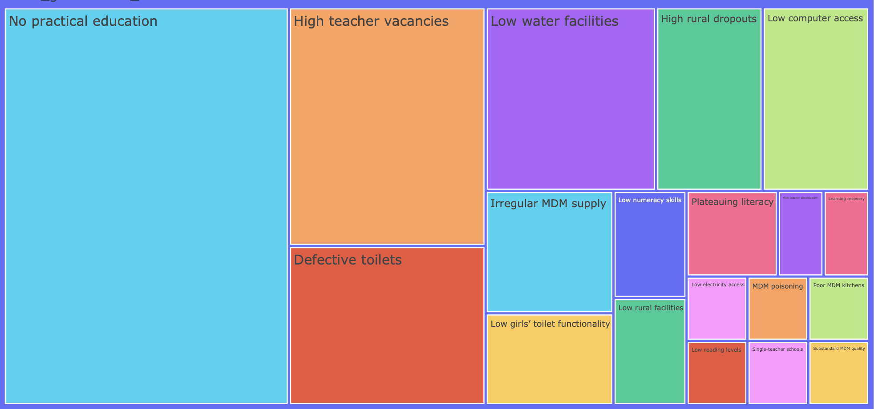
Operational Failures in Education
Key Points:
Lack of Practical Education
Teacher Vacancies
Infrastructure Issues –
Defective or non-functional toilets (especially for girls)
Low access to clean water and electricity
Poor Technology Access – Minimal computer infrastructure in schools
Mid-Day Meal (MDM) Failures
Irregular supply
Substandard quality
Poisoning incidents
Rural Disparities
High dropout rates
Single-teacher schools
Academic Quality
Plateauing literacy and low reading/numeracy skills

Slide 11
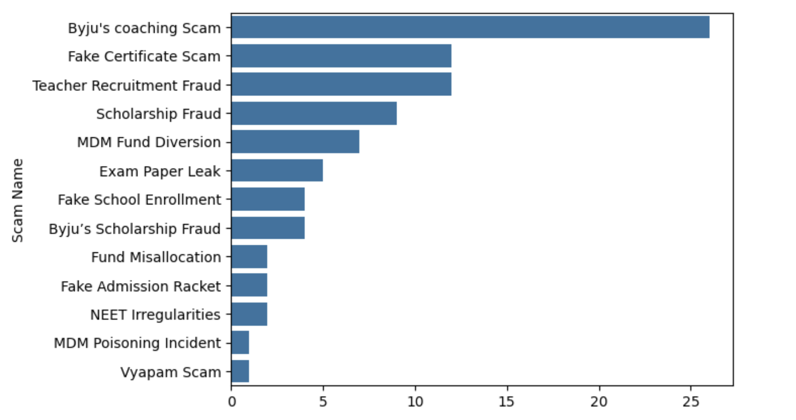
Corruption and Scams in the Education system
Key Points:
Top Scams:
Byju's Coaching Scam
Fake Certificate and Teacher Recruitment Frauds
Scholarship and MDM Fund Diversions
Common Scams:
Fake admissions and enrollments
Exam paper leaks and NEET irregularities
Misuse and misallocation of public funds
Impact:
Erosion of trust in education
Financial and mental stress for students
Compromised academic standards

Slide 12
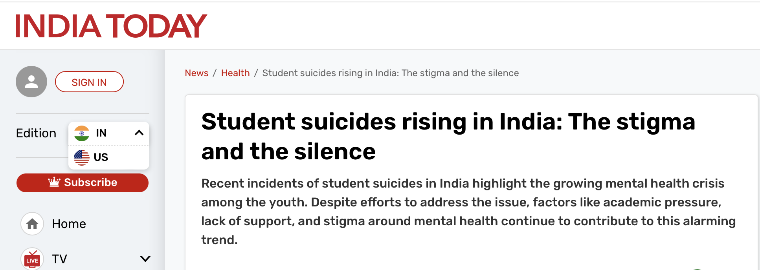
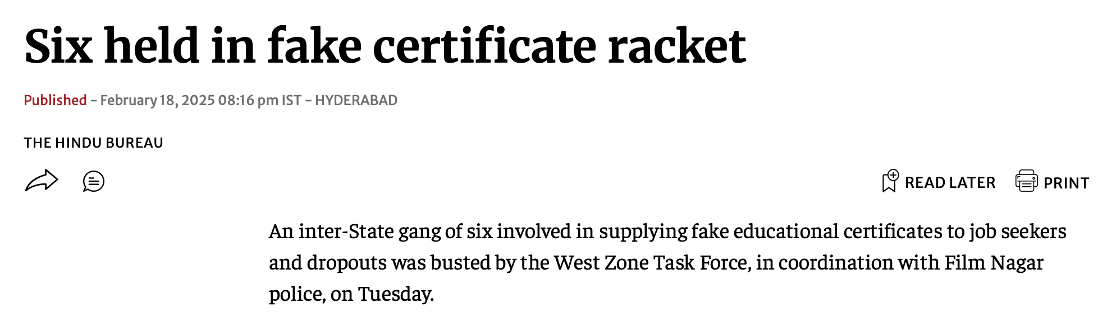
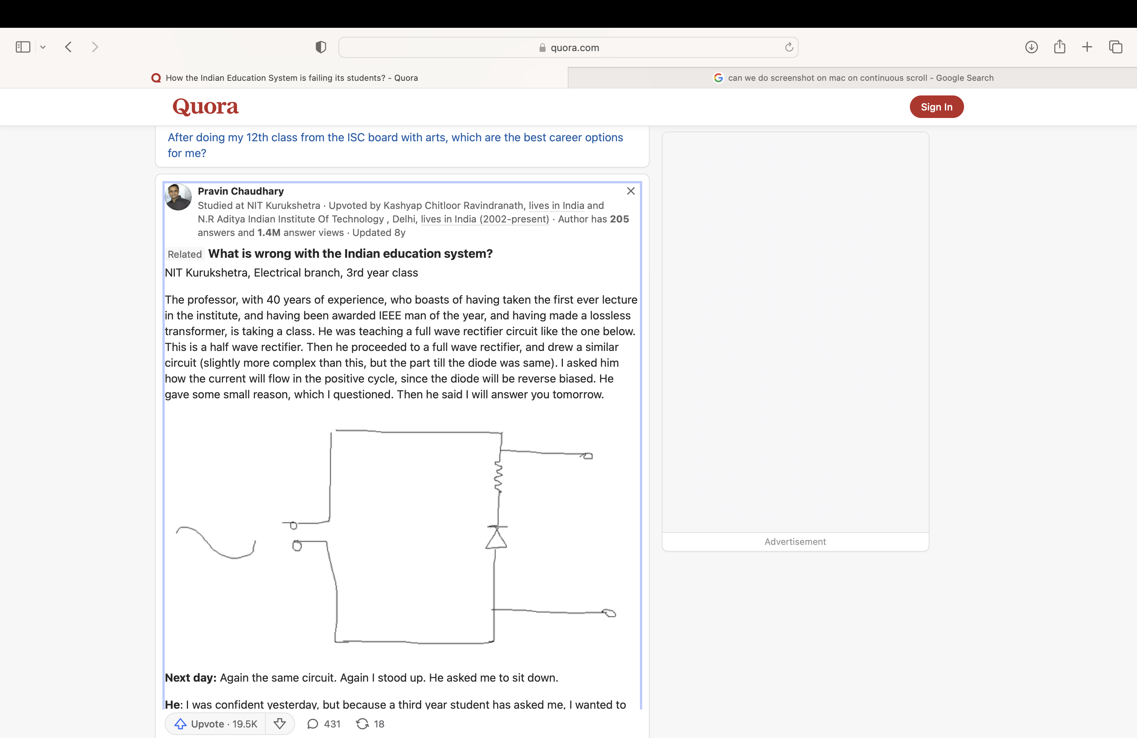
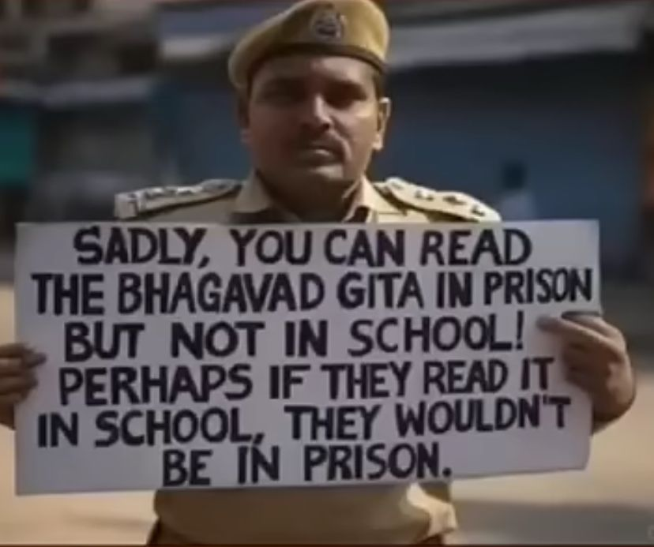
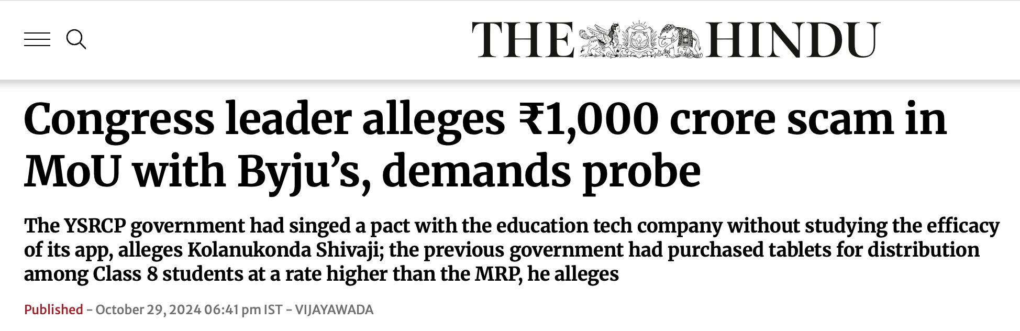


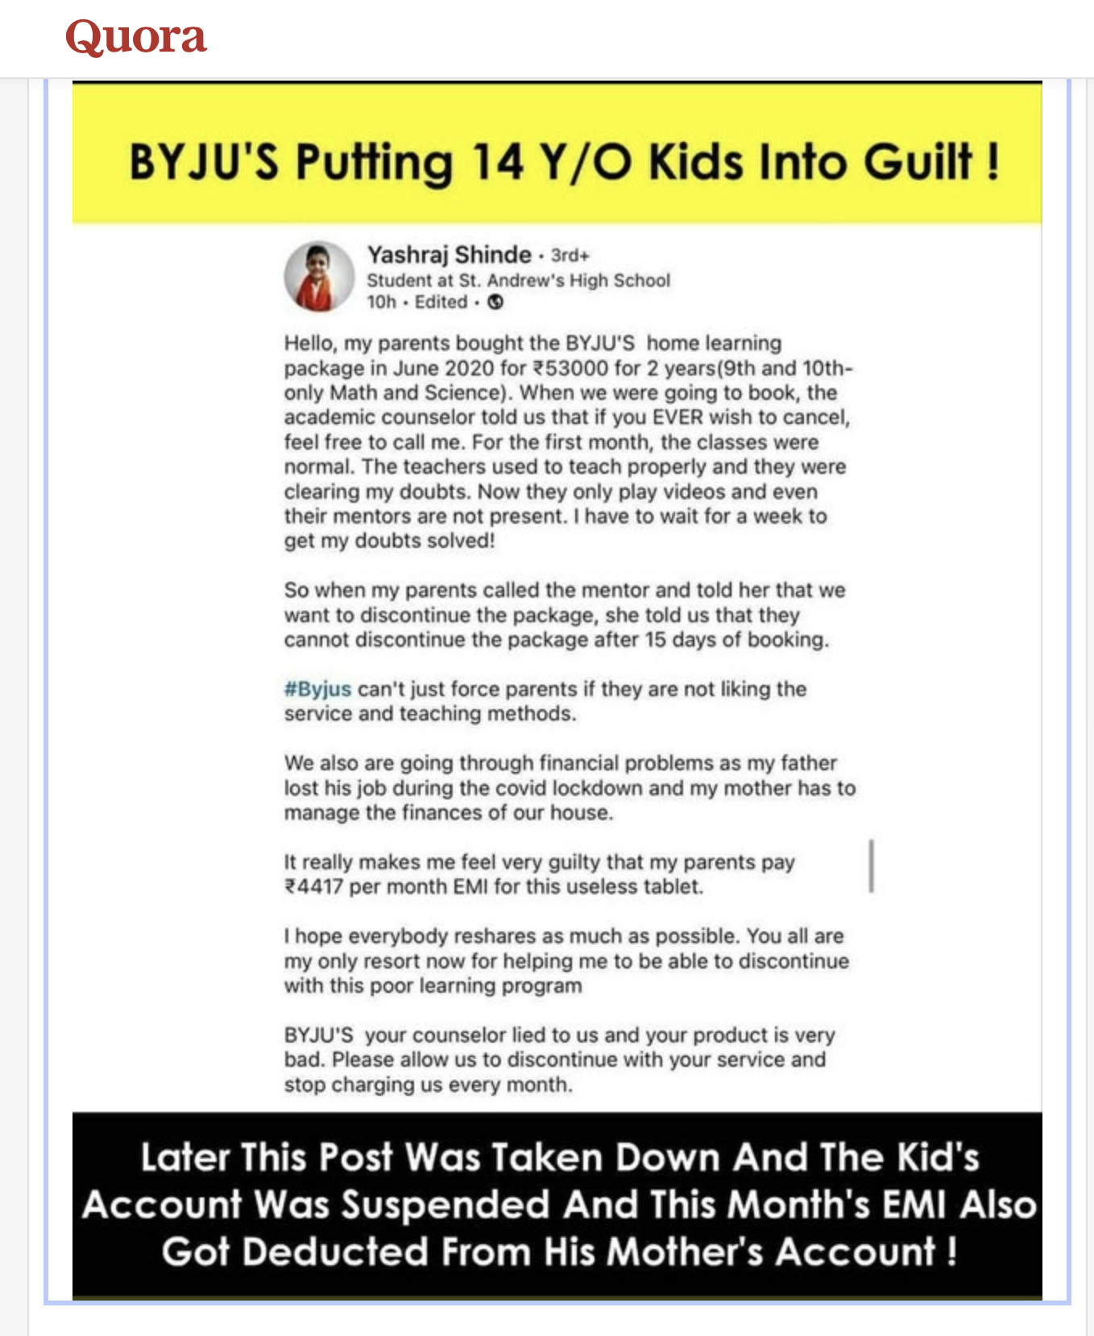

Slide 13
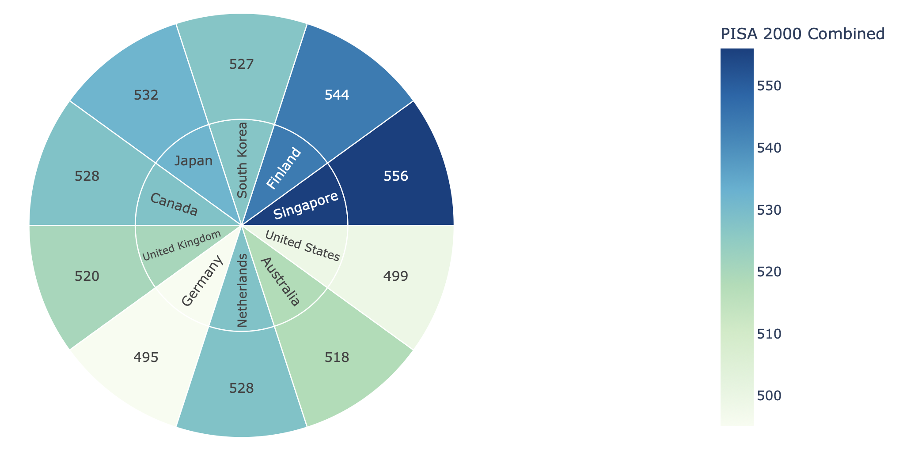
International Comparison – PISA Scores
India: Participated only once in 2009; performed poorly
Top Performers (2022 PISA):
Singapore (1st in reading, math, science)
Finland, Japan, South Korea, Canada
Country | Reading | Math | Science
Singapore | 1st | 1st | 1st
Japan | 3rd | 2nd | 3rd
Finland | 2nd | 3rd | 2nd
India (2009) | 72nd | 73rd | 72nd

Slide 14
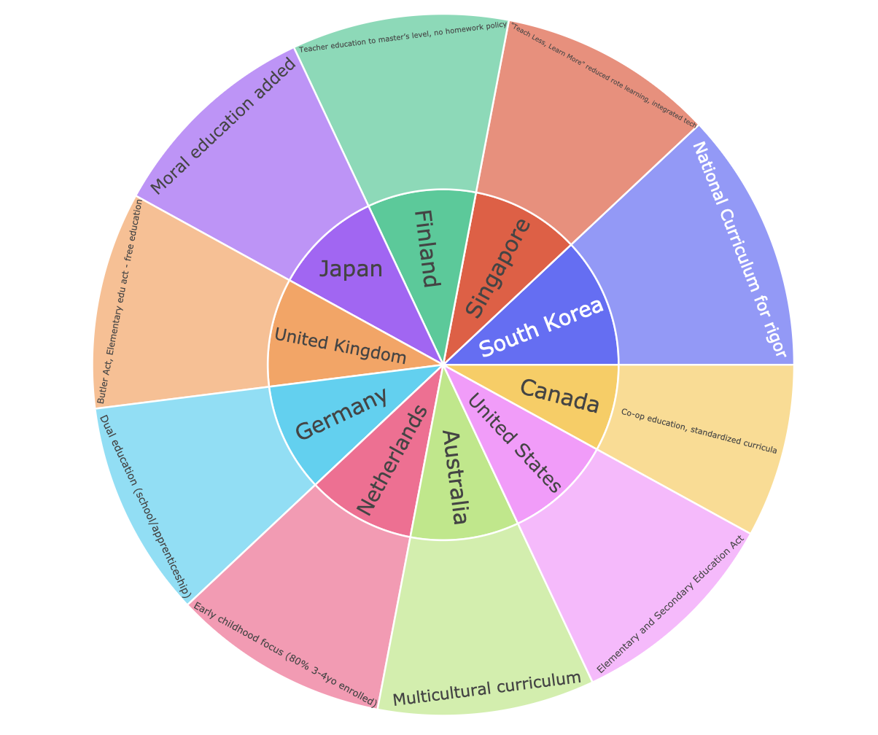
Global Best Practices in Education
Key Highlights by Country:
Finland – Teacher education at master’s level, no homework policy
Singapore – “Teach Less, Learn More” initiative promoting deep learning
South Korea – National curriculum emphasizing academic rigor
Canada – Co-op education, standardized national curricula
United States – Elementary and Secondary Education Act
Australia – Multicultural curriculum approach
Netherlands – Strong early childhood focus (80% of 3–4-year-olds enrolled)
Germany – Dual education system (school + apprenticeship)
United Kingdom – Butler Act: Free elementary education
Japan – Moral education integrated into curriculum
Takeaway:
These countries showcase how policy-driven, inclusive, and innovative approaches lead to high-performing education systems. These models can inform reforms in countries facing academic stress and mental health crises.

Slide 15
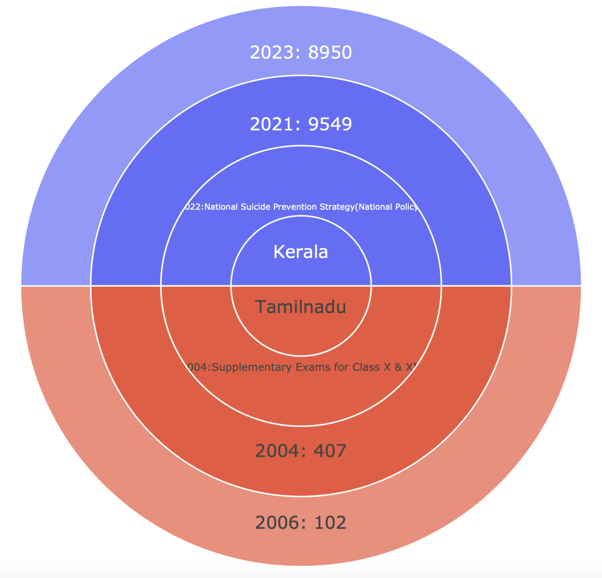
Policy Interventions and Impact on Student Suicides
Key Observations:
Kerala
Policy: 2022 – National Suicide Prevention Strategy (National Policy)
Impact:
Suicides dropped from 9,549 (2021) to 8,950 (2023)
Early signs of success in implementing nationwide mental health interventions
Tamil Nadu
Policy: 2004 – Supplementary Exams for Class X & XII
Impact:
Suicides decreased from 407 (2004) to 102 (2006)
Shows effectiveness of reducing academic pressure through alternative assessment methods
Takeaway:
Policy-level changes addressing mental health and academic flexibility can lead to measurable reductions in student suicides.

Slide 16
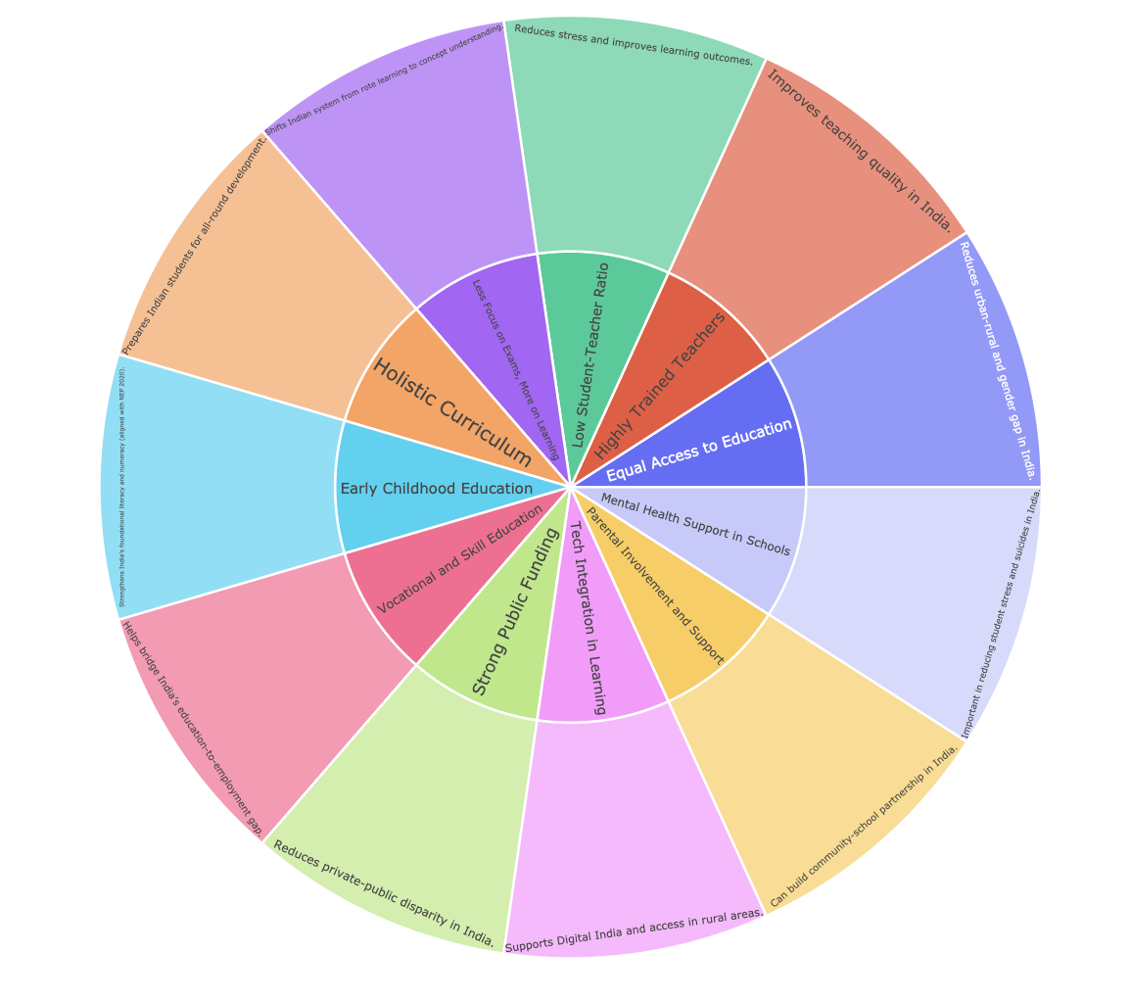
Business Insights
Key Pillars for Strengthening India's Education System
Main Reform Areas and Their Impacts:
Holistic Curriculum
Equal Access to Education
Highly Trained Teachers
Low Student-Teacher Ratio
Early Childhood Education
Vocational and Skill Education
Strong Public Funding
Takeaway: India’s educational reform must be multifaceted, targeting access, quality, well-being, and equity—ensuring students not only learn but thrive.

Slide 17
Conclusion:
”National suicide prevention policy and supplementary examination policy show how policies can reduce student suicides. Global models offer India a path forward through reforms in curriculum, teacher training, and access."

Slide 18
Data Cleaning:
Education – Concatenated year-wise Data Frames
pd.concat([df1,df2],axis = 1)
df["State"].ffill(inplace = True)
df["Scam Name"].replace("Byju's Scam","Byju's coaching Scam",inplace = True)

Slide 19
References
NCRB Suicide Data (2022)
PISA Reports (OECD)
Ministry of Education Policies (NEP 2020)
WHO + National Suicide Prevention Strategy (India, 2022)

